Slide 1
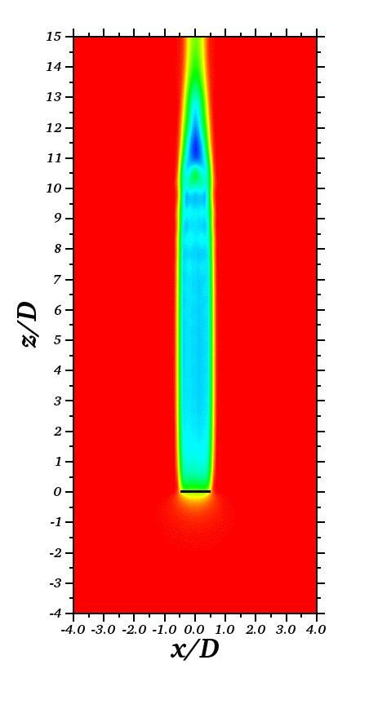

Barge
Spar

Slide 2
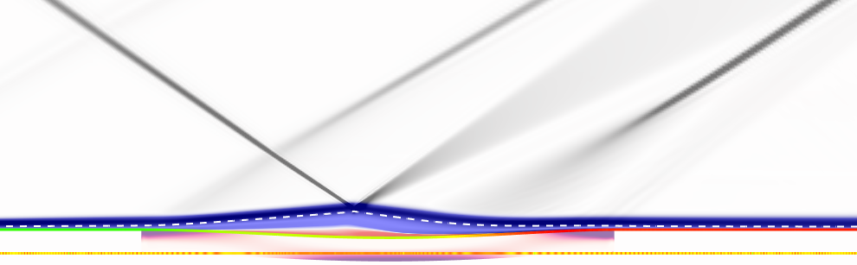
Reflected shock
Reattachment shock
Impinging shock
Sonic line

